Slide 1
NLP Sentiment Analysis
Ching and Chloe

Slide 2
TABLE OF CONTENTS
01
04
Business Question
Models Creation & Evaluation
02
05
Data Collection
Conclusion , Future Improvements & Next Steps
03
Preprocessing

Slide 3
01
Business Question

Slide 4
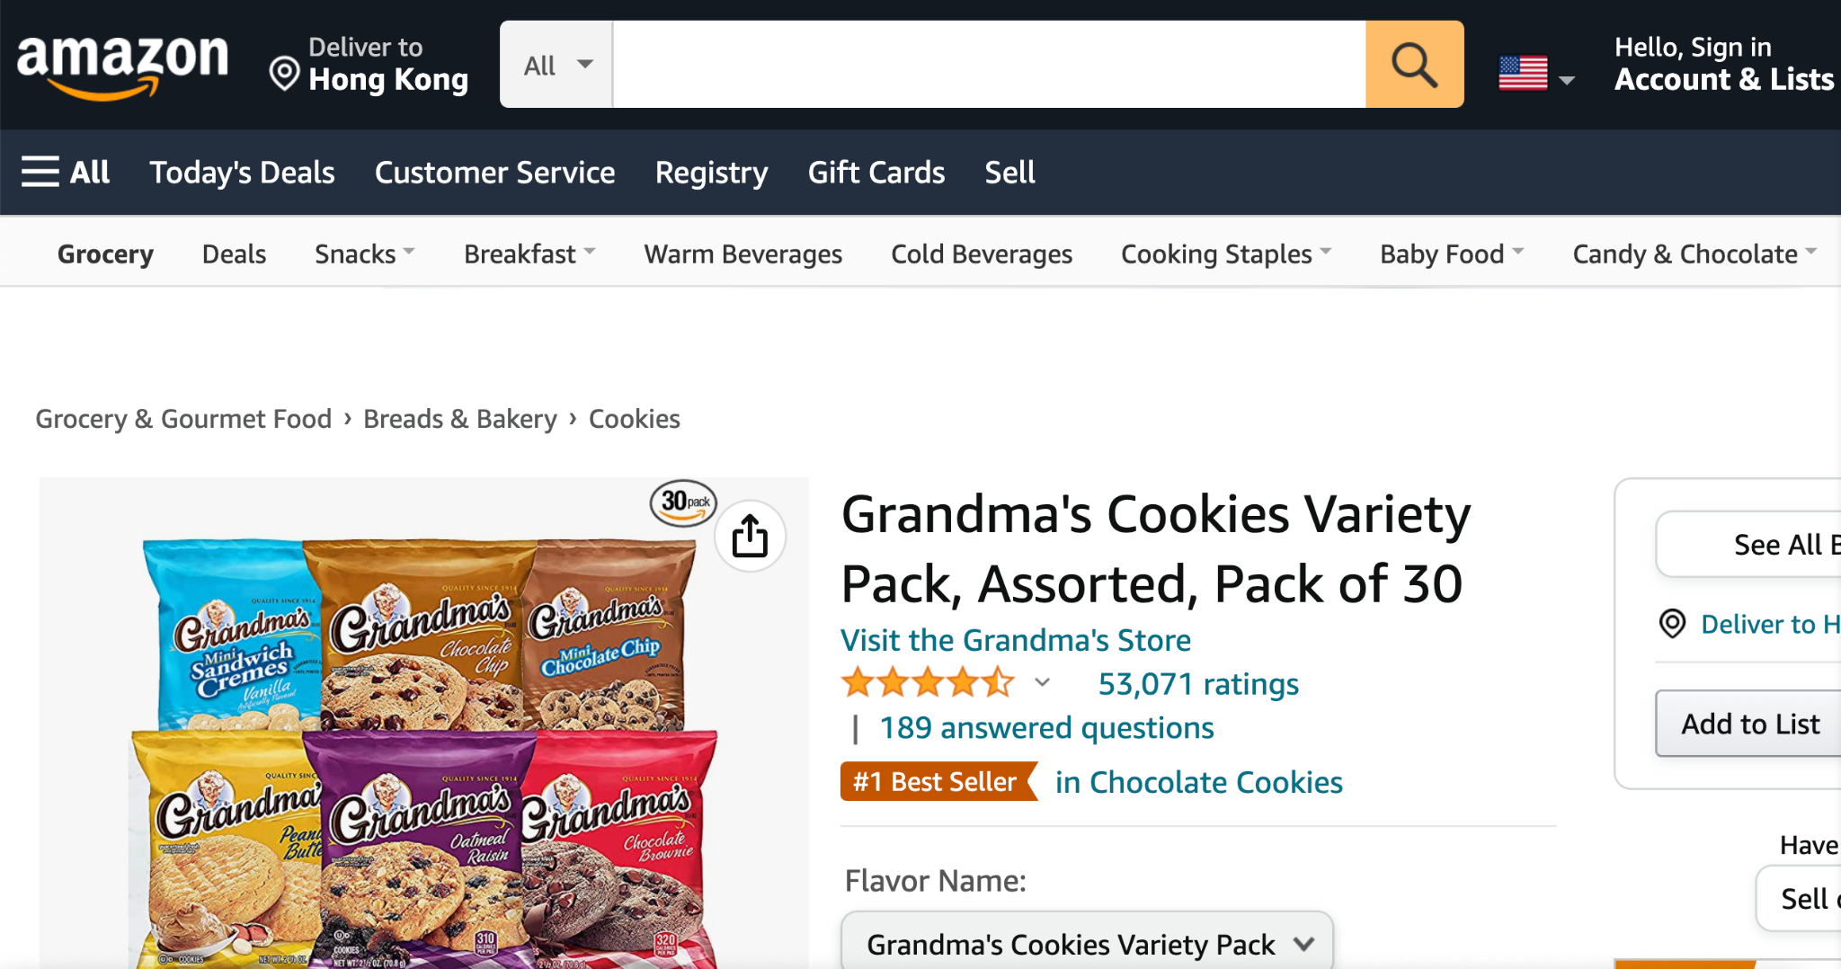
Business Objectives
Boost Sales by better marketing tatics
By analysing customers’ sentiment, company can know the trend and feature particular products
Improve company’s products & services
Customers may reviews some issues within the products or certain problems when using the services. Company could address those bugs and provide better one.

Slide 5

Business Objectives
Track sentiments in real-time
Retaining customers could generate more than half of the total revenue.
Hence by tracking real-time, company could quickly identify if sudden changes happened in customers’ feeling. They could react promptly to retain the existing customers.
Maintain brand preception
Customers value brand image. Yet, it requires long time to build the reputation. But at the same time,, it could be ruined within a single day. It is important to monitor the customers’ feeling towards the products.

Slide 6
02
Data Collection

Slide 7

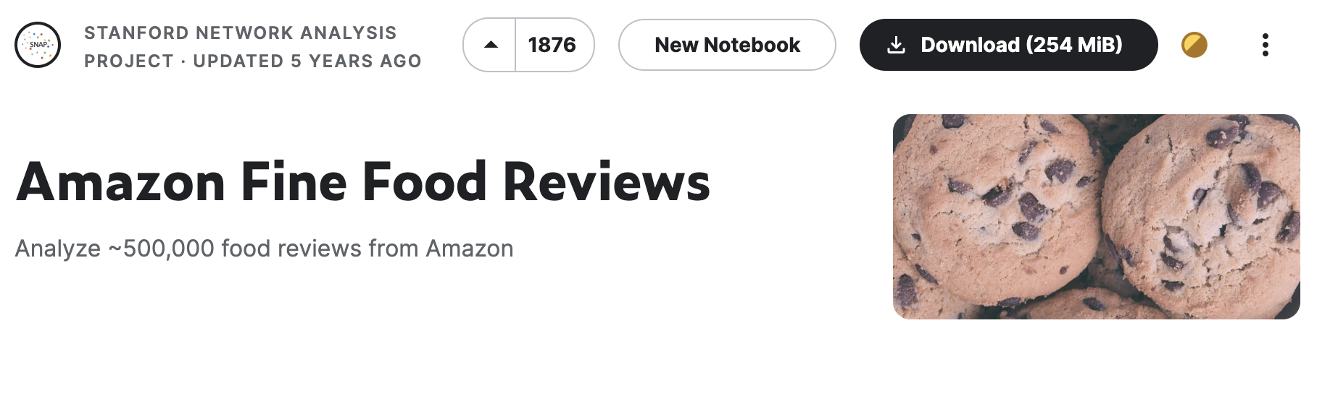
Data Collection
https://www.kaggle.com/datasets/snap/amazon-fine-food-reviews
Notes:
https://www.kaggle.com/datasets/snap/amazon-fine-food-reviews

Slide 8
03
Data Preprocessing

Slide 9
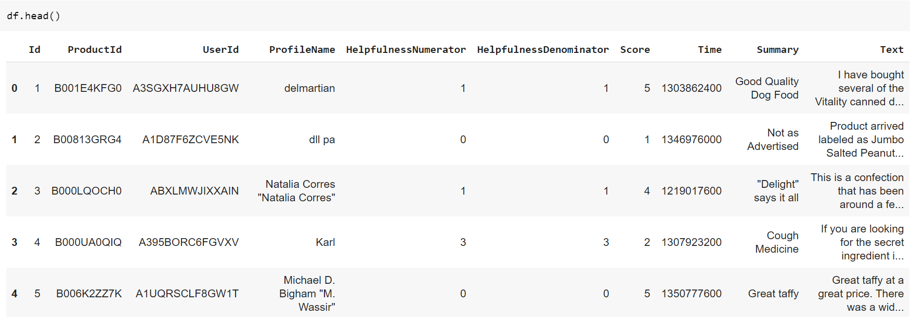
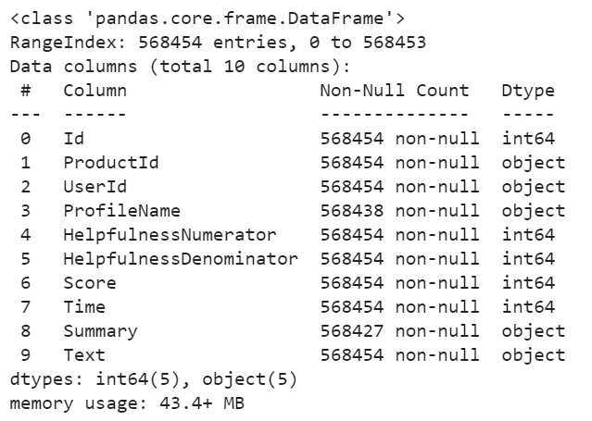
Data Preprocessing
Original Dataset

Slide 10
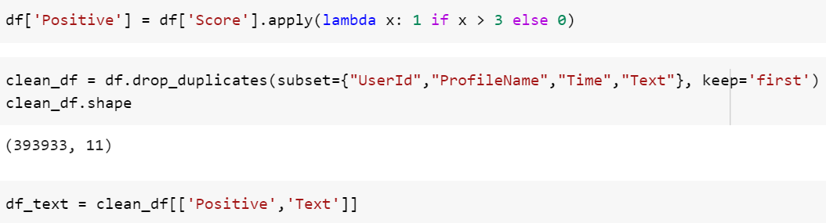
Data Preprocessing
1 . Create a binary column and define score > 3 is positive, O.W. negative.
2. Drop duplicate rows by checking “UserID”, “ProfileName”, “Time” and “Text”.
3. Only extract two columns (the comment itself, positive/negative)

Slide 11
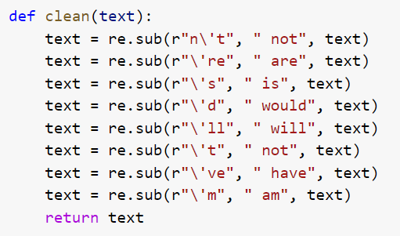
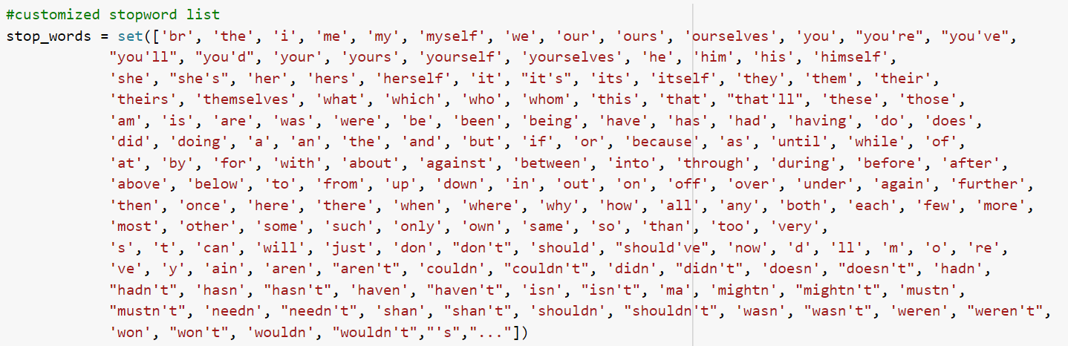
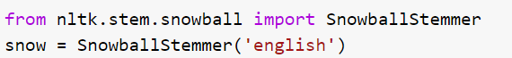
Text Preprocessing
1 . Clean contractions
2. Define customized stopword list
3. Import SnowballStemmer

Slide 12
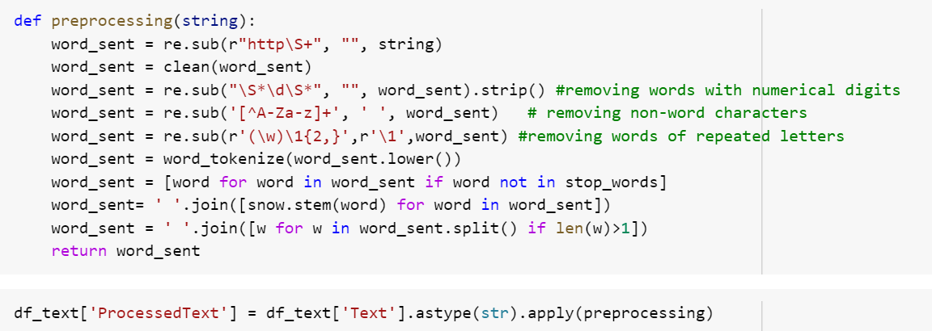
Text Preprocessing
1 . Use regex to clean:
(i) website links; (ii) words with numbers (e.g. 200ounces, 18yo);
(iii) words with repeated letters (e.g. yummmmmyyyyy, ahhhhh)
2. Convert the texts into lower case and tokenize into words
3. Exclude stopwords
4. Stem the word tokens by Snowball Stemmer

Slide 13
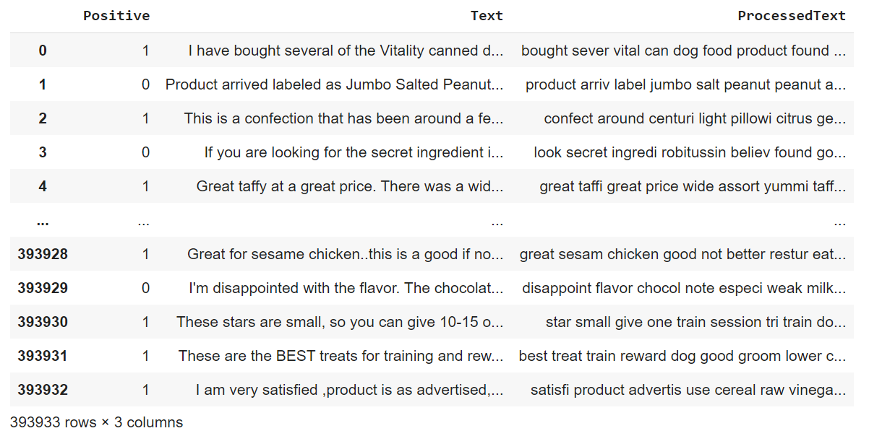
Data Preprocessing
Final Dataframe

Slide 14
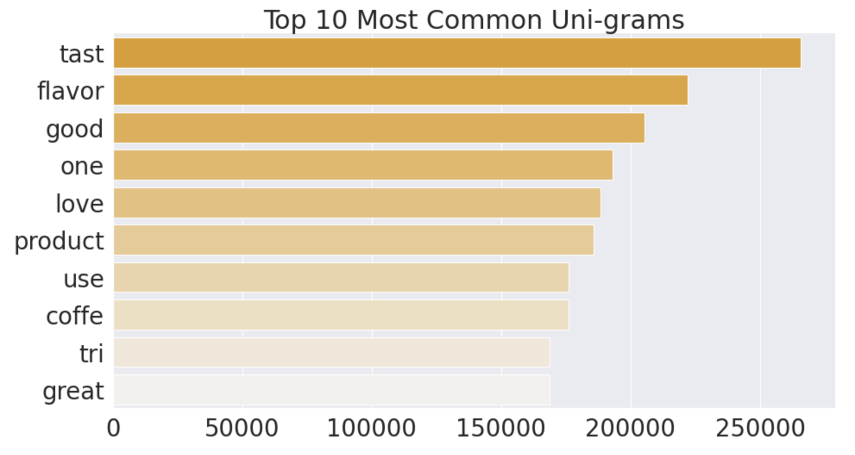
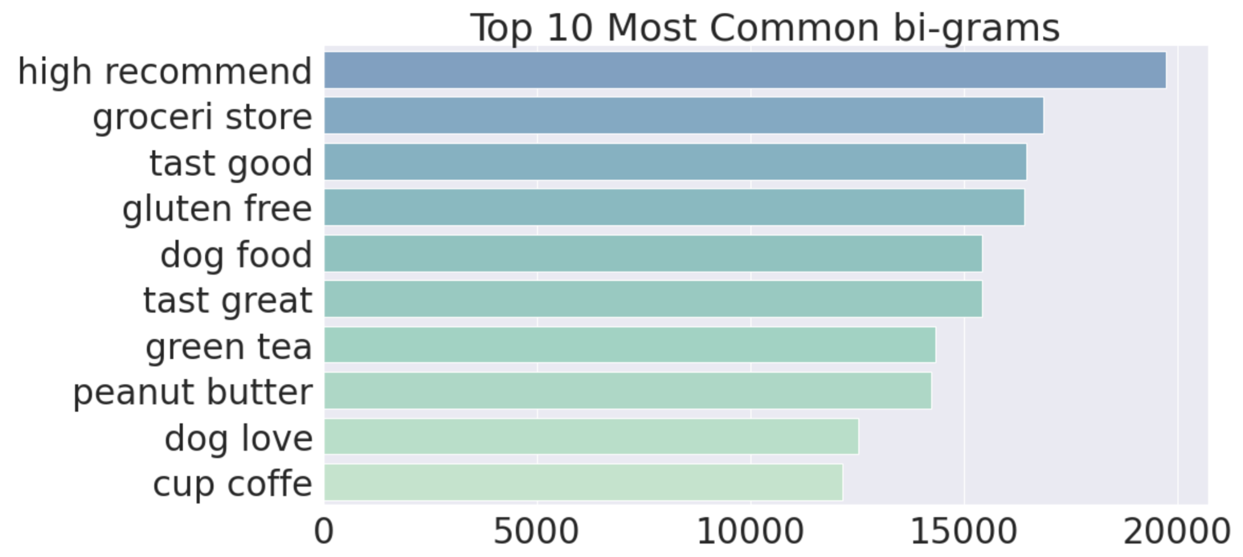
Data Preprocessing
Finding the most frequent unigrams and bigrams
generally positive

Slide 15
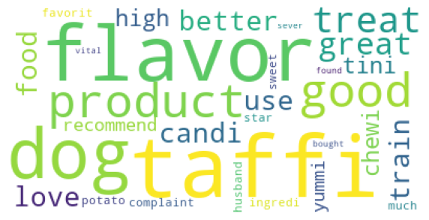
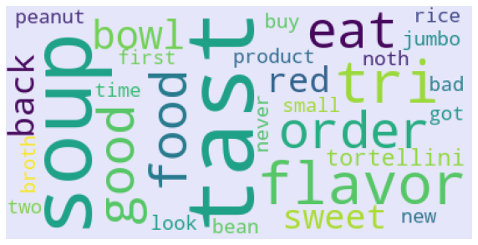
Data Preprocessing
Visualize the most frequent words using wordcloud
positive reviews (Score 4-5)
negative reviews (Score 1-3)

Slide 16
04
Models Creation

Slide 17
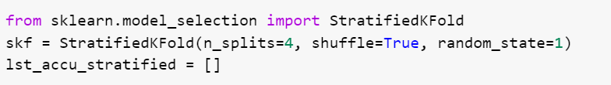
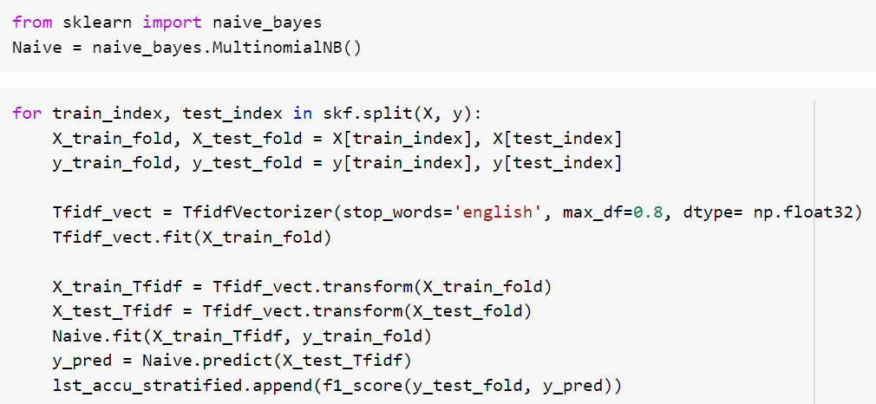
Models Creation
Stratified K-fold Cross Validation
Create a Naive Bayes model

Slide 18
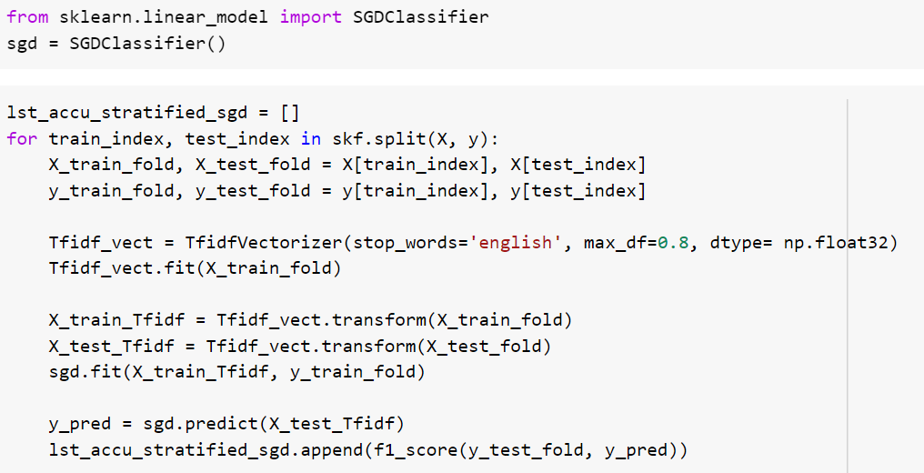
Models Creation
Create a model of SGDClassifier (Suitable for large and sparse dataset)

Slide 19
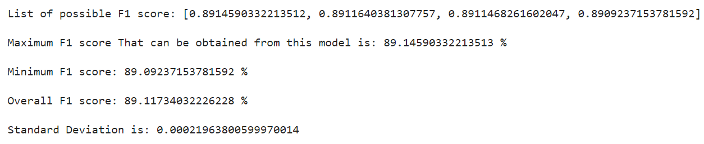
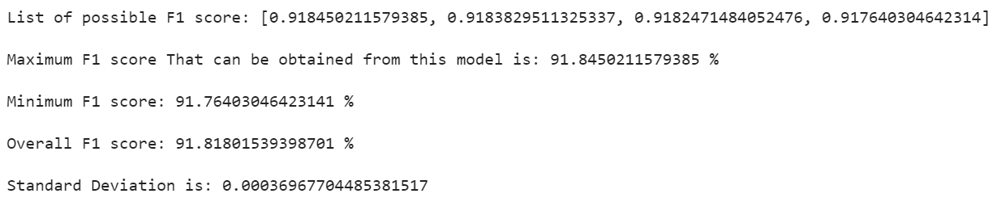
Models Creation
F1 Score of the Naive Bayes Model after Cross Validation
Small standard deviation → robust models
F1 Score of the SGDClassifier Model after Cross Validation
✔

Slide 20
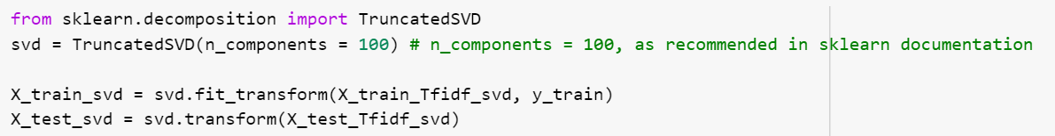
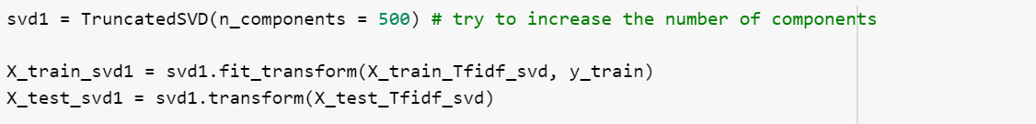
Models Creation
Dimensionality Reduction
Baseline SGDClassifier model: 73780 features ; F1 Score: 91.81802%
TruncatedSVD transformer is often used on count/tf-idf matrices, known as latent semantic analysis (LSA).
100 components:
F1 Score: 89.38094%
✔
500 components:
F1 Score: 90.95921%

Slide 21
Findings (Unigram TD-IDF)
 | Features | Importance
1 | great | 3.987900
2 | best | 3.344341
3 | love | 3.066141
4 | delici | 3.026104
5 | perfect | 2.716438
6 | excel | 2.489259
7 | amaz | 2.154049
8 | good | 2.134706
9 | awesom | 1.851652
10 | favorit | 1.830844
 | Features | Importance
1 | disappoint | -4.488774
2 | worst | -3.522368
3 | ok | -3.468223
4 | return | -3.306934
5 | aw | -3.040941
6 | unfortun | -2.956783
7 | terribl | -2.927215
8 | horribl | -2.865595
9 | okay | -2.714790
10 | bland | -2.639161

Slide 22
Findings (Bigram TD-IDF)
 | Features | Importance
1 | high recommend | 0.690828
2 | pleasant surpis | 0.428914
3 | tast great | 0.350020
4 | great product | 0.344050
5 | definit buy | 0.335500
6 | great tast | 0.319084
7 | love stuff | 0.310013
8 | bast tast | 0.300389
9 | realli good | 0.299654
10 | far best | 0.292919
 | Features | Importance
1 | wast money | -5.883018
2 | wo buy | -2.909699
3 | disappoint product | -1.438679
4 | threw away | -1.405127
5 | buyer bewar | -1.340235
6 | bad batch | -1.300711
7 | wo order | -1.261163
8 | throw away | -1.220730
9 | tast bad | -1.210144
10 | tast ok | -1.192638

Slide 23
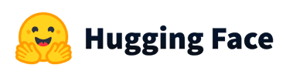
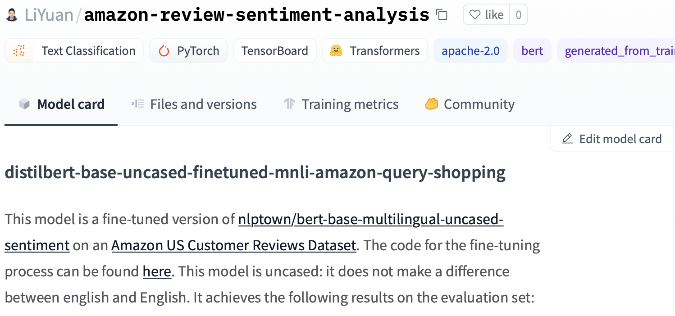
Models Creation

Slide 24
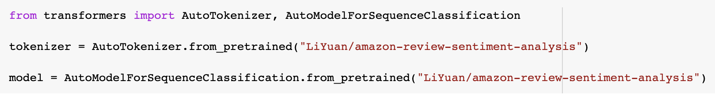
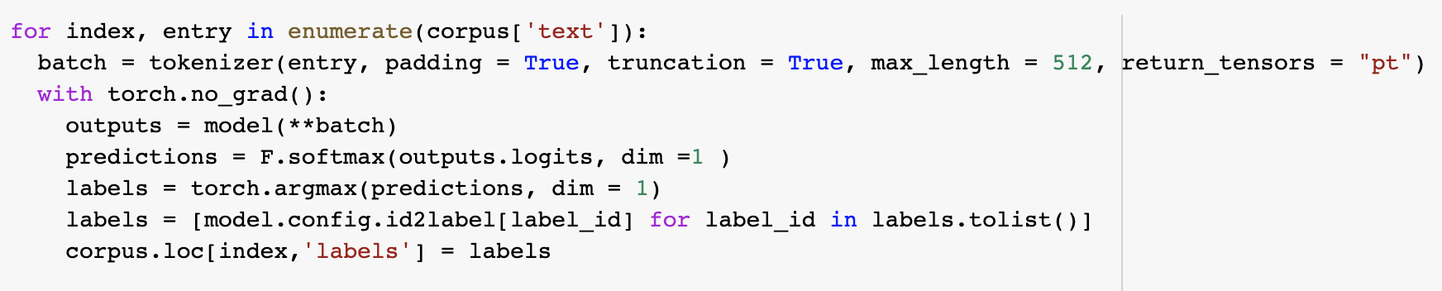
Models Creation

Slide 25
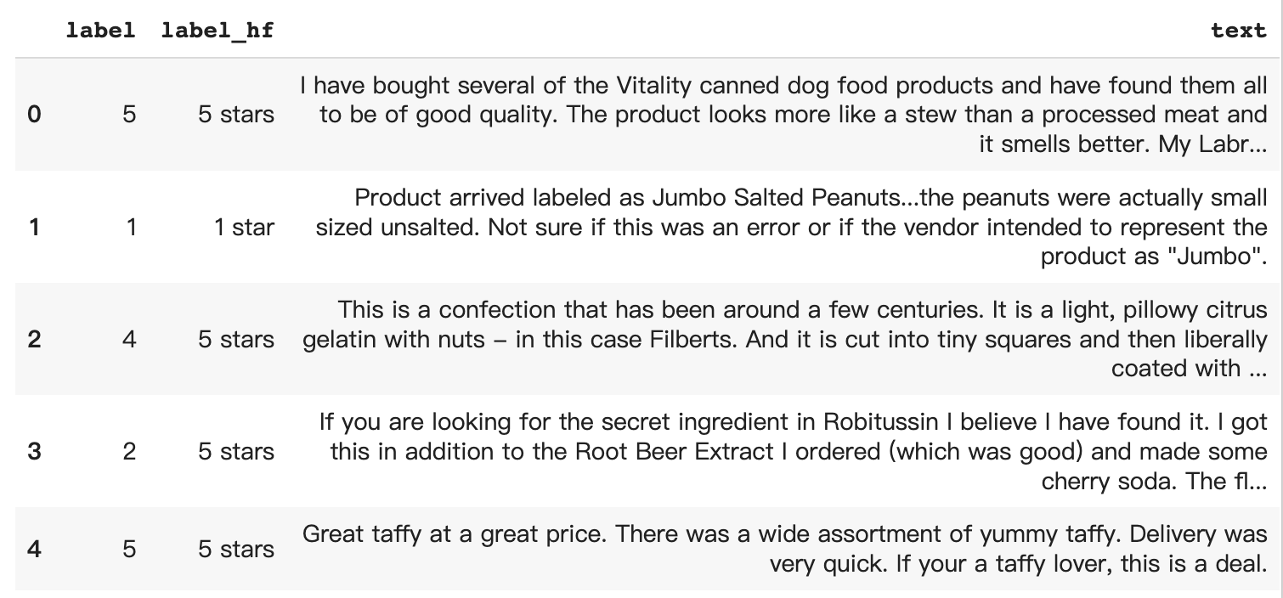
Models Creation

Slide 26
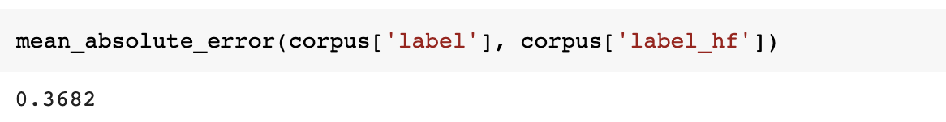
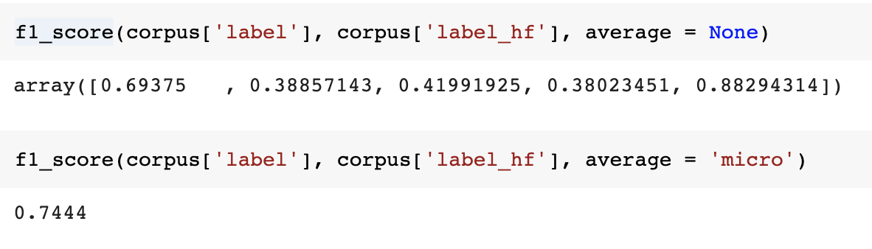
Models Creation

Slide 27
06
Conclusion & Future Improvements

Slide 28
Conclusion & Future Improvements
Limitations
Dataset is pretty large, requires long time to process
No real-time tracking as Amazon.com cannot be scrapped directly
Future Improvements
Apply bagging/ big data techniques
Look for other data sources which updates regularly for real-time tracking

Slide 29
Next Steps
1
2
Better Visualization
Compare with Competitors
Using BI tools e.g. Tableau to create a dashboard that make it more user-friendly
Conduct similar sentiment analysis on competitors to know the opportunities and threats

Slide 30
THANKS!

